Slide 1
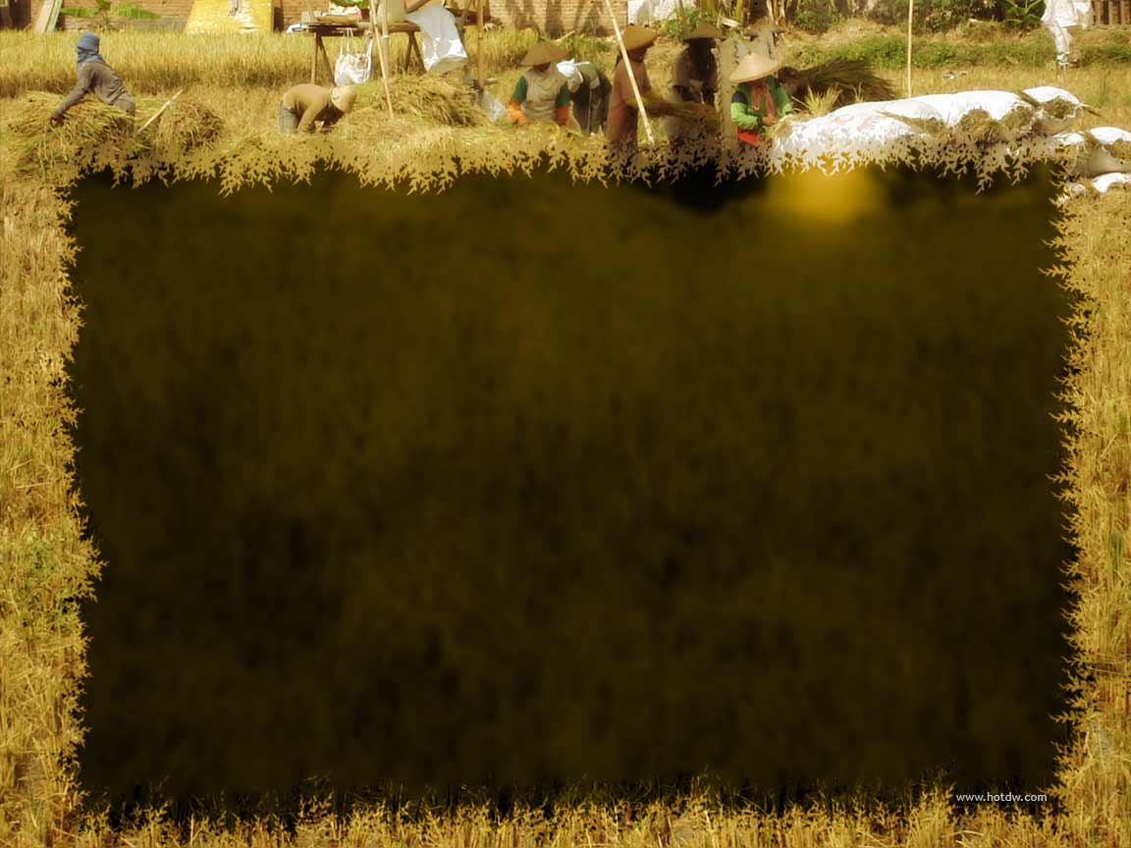
Mid-Term Program Assessment of the Sikat Saka Program (SSP)
Dr. Fezoil Luz C. Decena
Lead Consultant, ASPSI
Final Report
ACPC

Slide 2
Outline of Presentation
Introduction, Objectives, Framework, and Methodology
Results and Discussion
  Performance Evaluation
    Process of SSP implementation in the field
    SSP reach
  Impact Evaluation: Survey Results
    Profile (farmer and farm)
    Credit information – access, utilization, repayment, problems
    Impact - partial budget and PSM
    Perception of respondents on SSP (by institution)
Conclusions and Recommendations

Slide 3
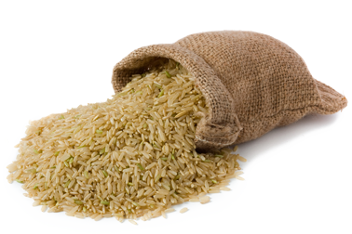
Introduction
one of the six programs under Agro-Industry Modernization Credit and Financing Program (AMCFP)
launched in 2012 with the goal to (a) help more palay farmers access timely, adequate and affordable production credit, and (b) improve the viability of agricultural production by ensuring availability of irrigation services, extension, links to markets and providing a favorable economic environment
integrated financing program jointly implemented by
  DA, ACPC, ATI, NIA, NFA
  LBP, PCIC

Slide 4
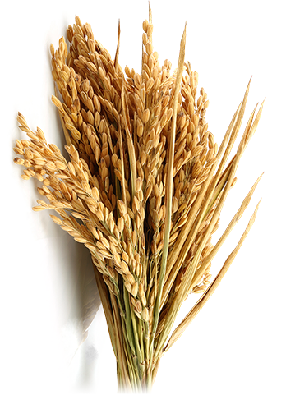
Objectives
General: to determine the program accomplishments vis-a-vis its component targets/objectives.
Specific :
1. Evaluate to what extent the SSP had contributed to (a) increasing agricultural productivity and income; (b) rice self-sufficiency objectives; and (c) improving the quality of life (e.g., living conditions, access to basic services, among others) of small rice and corn farming households;
2. Determine if access to formal credit of small palay and corn farming households has improved as a result of the SSP in terms of outreach, that is, the amount of loans granted and the number of farmer borrowers (including new borrowers), as well as funds leveraging, and compliance with the agreed lending terms and conditions such as interest rate, eligibility criteria, documentary requirements, status of service conduits, and repayment performance, among others;

Slide 5
Objectives
3. Evaluate to what extent the NFA and/or other reliable buyers have absorbed produce of palay and corn of farmer-borrowers;
4. Determine the extent to which the ATI has complied with the requirements of the program and its contribution to increasing the credit worthiness and discipline of farmer-borrowers;
5. Determine the extent to which the conduits (including service conduits) have complied with the program’s lending terms and conditions;
6. Identify successful features/aspects of the SSP and operational bottlenecks and problems; and
7. Provide recommendations on how to further strengthen the delivery of credit services to small farmer households.

Slide 6
Framework
Input
Funds Released by ACPC for SSP
Process
LBP Manages Funds and Retails to Rice and Corn Farmers
Output
Farmer’s Relative Access to Credit Improves
Outcome
Higher investment in Farm Inputs/Use of Better Technologies
Impact
Higher Productivity and Income
Performance Evaluation
Impact Assessment
Figure 1. Performance evaluation and impact assessment

Slide 7
Framework
Q
TP₁
TP₀
x₀
x
Figure 2. Shift in total product curve due to intervention

Slide 8
METHODOLOGY

Slide 9
Survey Areas and Sample Size
Province | Number of Beneficiaries | Municipalities (with FGD) | Number of Samples |  |  | Total
 |  |  | Bene | Non-Bene
Isabela | 2,265 | Alica, Santiago, San Pablo | 96 |  | 96 | 192
Nueva Ecija | 1,788 | Guimba, San Antonio, Gen. Natividad | 95 |  | 95 | 190
Occidental Mindoro | 1,001 | Rizal, Calintaan, Sta Cruz | 92 |  | 92 | 184
Bukidnon | 377 | Valencia, Malaybalay, Quezon | 93 |  | 93 | 186
Bohol | 517 | Pilar, Ubay, San Miguel | 86 |  | 86 | 172
Iloilo | 194 | Oton, Banate, Barotac Viejo | 65 |  | 65 | 130
Total | 7,044 |  | 527 |  | 527 | 1084
Identified the top 6 provinces (already covers 50% of bene) as of April 2017 based on LBP database
Slovin’s Formula with 10% margin of error to determine number of beneficiaries (and equivalent number of non-beneficiaries
Top three municipalities with highest number of borrowers

Slide 10
Key Informant Interviews
  LBP Headquarters and Lending Centers
  ACPC
  NIA Offices (Regions)
  NFA (Regions) and Bohol Rice Processing Center
  ATI (Regions)
  Irrigators Associations – in selected municipalities covered
  PCIC

Slide 11
Analytical Procedures
Performance Evaluation
Documentation and Analysis of the inputs
Performance Parameters
Efficiency of partner banks/conduits
Descriptive Statistics
Impact Assessment
Partial Budget Analysis
Propensity Score Matching
  Probability Logistical (Probit) Model
  Average Treatement Effect of the Treated

Slide 12
RESULTS
AND
DISCUSSION

Slide 13
A. PROGRAM IMPLEMENTATION ANALYSIS

Slide 14
Table 4. Process of Sikat Saka Program loan application and release
Responsible Entity | Process | Requirement
 | Endorsement
Irrigators Association | Pre-screens and consolidates (at least 40) farmer-members based on eligibility requirement | Should be member of IA Not a member of any cooperative No previous loan for the last 6 months with LBP owns 0.50 to 5.0 ha with clean title
Farmer | Applies loan, secures and prepares requirements | purchase order from NFA, NABCOR or other reliable buyer attend briefing and/or seminar conducted by ATI collateral requirement: title of land, certification, OR/CR of motor vehicle farm plan and budget
Irrigators Association | checks completeness of submissions of farmers and prepares additional requirements | certification of no previous loan from LBP summary of farmers availing loan containing information on name of farmers, address, title number (TCT/ OCT/ CLOA), location of farm, amount of loan being applied Management Takeover Agreement

Slide 15
Table 4. Continued…
Responsible Entity | Process | Requirement
National Irrigation Administration | Endorses participating IA to LBP
 | Loan Processing, Packaging and Administration
Land Bank of the Phils | Account officers process the loan application in accordance with existing guidelines of LBP Safekeep land titles and return the same upon full payment Facilitate farmers’ opening of deposit account with LBP branch and execute an auto-debit arrangement with LBP for payment of loan File AGFP guarantee application and claims in cases of past due loans | Use of a simplified loan application form Loan amount is based on the farm plan and budget but not to exceed loan ceiling of P41,000/ha for inbred and P50,000/ha for hybrids Interest rate is 15% per year for the first 2 cycles, reduced by 1% per year for every succeeding cycle on loans fully paid up to the 8th cycle
 | Loan Approval and Release
Land Bank of the Phils | Approves of loans by designated approving authorities Releases loan to farmers through ATM accounts Provides NFA/NABCOR list of releases which will serve as basis to pay to farmers for palay purchases | Collateral for safekeeping Management Takeover Agreement

Slide 16
Table 5. Sikat Saka Program Implementation on the Ground
Provision | Practice on the Ground | Province
Size of farm and amount of loan | Loan ceiling of 80% of farm budget plan, not to exceed P41,000/ha for inbred and P50,000/ha for hybrid Size of farm is 0.5 to 5.0 ha | All surveyed provinces
Membership to IA | Farmers who are members of more than one IA may borrow according to the number of their membership to IA | Nueva Ecija
 | Farmers with multiple IA membership is eligible only once Farmers of good standing is defined as those who pay their ISF | All surveyed provinces except Nueva Ecija
No existing loan from LBP | Still are allowed to borrow provided they have capacity to pay | Nueva Ecija
Attendance to Seminar | One day seminar on credit worthiness, and briefing of the SSP; organized by ATI Borrower attends trainings only once | All surveyed provinces
 | Seminars on rice production with resource speakers from DA and LGU Agricultural Office | Occidental Mindoro Bohol, Bukidnon
Purchase order | P.O. from NFA is issued only once, and may be reused for succeeding loan application as long the amount remains the same | Nueva Ecija
 | P.O. is issued every time a loan application is made; only farmers who bring in a certain percentage of their harvest from loan period can be issued another PO for another loan; uses passbook | Bukidnon (1%) Occidental Mindoro (70%)
 | NFA requires LBP receipt as proof that borrowers have no more accountability before issuing another PO Summary of farmers availing loans (from IA) | Occidental Mindoro

Slide 17
Table 5. Continued…
Provision | Practice on the Ground | Province
Purchase order | NFA needs endorsement of IA indicating some information to ensure capacity to pay based on projected harvest | All Provinces
 | PO issued by the Bohol Rice Processing Center and not by NFA. BRPC executes a Production, Technical and Marketing Agreement with the IA, farmer borrowers, LBP, NIA and DA | Bohol
 | PO issued upon endorsement of NIA, returned to NIA for onward submission to LBP | Iloilo, Nueva Ecija, Isabela
Loan Security and Collateral | Promisory note and management takeover agreement (notarized) Certificate of land title Certificate of registration and official receipt of motor vehicle Certification from land owner (for tenants) Certificate of mortgage | All surveyed provinces
 | Animal registration | Occidental Mindoro Bohol, Bukidnon
 | Certificate of ownership of appliances | Bukidnon
Interest rate | 15%/annum or 7.5%/season; declining at 1%/season until 9th season where interest is only 8% | All surveyed provinces
Incentives to IA | 0.5% for 100% repayment rate and 0.25% for 90 – 99% repayment rate | All surveyed provinces
NIA | identifies IAs of good standing issues certificate that IA is of good standing issues certificate of water availability | All provinces

Slide 18
No uniform practice or process followed in issuance and use of PO
- Not all PO’s are used (for disposal of harvest or for payment of loan)
Uses 3 criteria in determining IA for endorsement to LBP:
- IA should be in good standing (ISF)
- Farmer-borrower has no outstanding loan with LBP
- Water availability
Assists in identifying farmer-borrowers
- Assists in requirements from NIA, NFA
- Consolidates and endorses loans
- Monitors payment
- Implements MTA (Mindoro)
LBP:
- Nueva Ecija – has a separate unit for SSP
- Different collaterals – some still use animal registration, use of appliance (Bukidnon), ownership of land (Bohol)
Notes:
Different practices

Slide 19
Best Practices: IA
Selection of borrowers
Uses criteria in selection of borrowers outstanding farmers
Processing of documents
Hire coordinators
Pay IA member for processing
Loan Payment
Monitoring
Payment is a shared responsibility
Discussed in meetings
Implementation of MTA
first offered to relatives
IA president takes over

Slide 20
Best Practices: Other agencies
NIA
Selection criteria based on outstanding IA (Bukidnon)
NFA
Requires farmers to bring 10% (Bukidnon) to70% (Mindoro) of their harvest before another PO is issues
PO is issued by reliable trader (Bohol RPC)
LBP
Ensures bank procedures are followed
Offers assistance in paper work
Innovates on treatment of bank collateral (Bukidnon)
Separate unit for SSP (N. Ecija)

Slide 21
Table 11. Loan amount, number of borrowers, area coverage of SSP as of April 2017
Region | Q12017 Loan Amount (M ₱)* | Cumulative Loan Amount (M ₱)* | Number of Borrowers* | SSP area for 2017 Loan ha)* | Total Irrigated Area (ha)** | % of irrigated area covered by SSP
CAR | 8.241 | 44.352 | 202 | 440 | 92,482 | 0.48
Region 1 | 2.484 | 65.519 | 422 | 678 | 137,929 | 0.49
Region 2 | 44.593 | 1,004.260 | 2833 | 6,690 | 271,697 | 2.46
Region 3 | 109.676 | 1,688.820 | 2879 | 7,183 | 293,438 | 2.45
Region 4 | 105.375 | 655.268 | 1670 | 5,049 | 137,433 | 3.67
Region 5 | 1.888 | 17.306 | 82 | 176 | 122,717 | 0.14
Region 6 | 7.115 | 175.809 | 866 | 1,422 | 106,941 | 1.33
Region 7 | 16.149 | 152.783 | 595 | 1,193 | 47,214 | 2.53
Region 8 | 2.835 | 46.991 | 348 | 543 | 69,090 | 0.79
Region 9 | 1.852 | 13.537 | 91 | 197 | 47,054 | 0.42
Region 10 | 43.428 | 94.428 | 362 | 839 | 65,782 | 1.28
Region 11 |  | 4.369 | 77 | 116 | 68,129 | 0.17
SOCCSKARGEN | 31.727 | 637.075 | 1646 | 3,560 | 111,940 | 3.18
ARMM | 0.150 | 15.647 | 47 | 111 | 47,866 | 0.23
CARAGA | 5.676 | 5.676 | 36 | 123 | 62,452 | 0.20
Philippines | 381.190 | 4,621.840 | 1,2157 | 28,322 | 1,682,162 | 1.68

Slide 22
Figure 5. Regional distribution of number of Sikat Saka borrowers by gender (%)
Source of basic data: LBP database, 2017
Notes:
35% female, 65% male

Slide 23
Figure 6. Regional distribution of Sikat Saka loan amount by gender (%)
Source of basic data: LBP database, 2017

Slide 24
Sikat Saka Program Reach by Island Group
Figure 7. (a) Total irrigated area, (b) SSP area coverage, (c) SSP borrowers,
and (d) SSP loan, by major island group, Q1 2017
Source of basic data: LBP database, 2017

Slide 25
Sikat Saka Reach in Luzon
Figure 8. (a) Sikat Saka cumulative loan amount, (b) 2017 loan amount, (c) number of borrowers (d) area coverage in 2017, Luzon
Source of basic data: LBP database, 2017
Notes:
Concentrated in regions 2, 3 and 4

Slide 26
Sikat Saka Reach in Visayas
Figure 9. (a) Sikat Saka cumulative loan amount, (b) 2017 loan amount, (c) number of borrowers, and (d) area coverage in 2017, Visayas
Source of basic data: LBP database, 2017

Slide 27
Sikat Saka Reach in Mindanao
Figure 10. (a) Sikat Saka cumulative loan amount, (b) 2017 loan amount, (c) number of borrowers and (d) area coverage in 2017, Mindanao
Source of Basic data: LBP database, 2017

Slide 28
Sikat Saka Reach: Survey data
Figure 11. Actual number of borrowers from 4 survey sites, 2012-2017
Source: LBP LC Centers, 2017
Notes:
Showing the increasing trend in number of borrowers in the survey areas as per LBP LC data

Slide 29
Figure 12. Trend in number of borrowers from the survey areas, 2012-2017
Notes:
Survey data confirming the LBP LC data on the trend on increasing number of borrowers in the survey sites

Slide 30
RESULTS OF THE SURVEY
Table 13. Socio-economic profile of respondents
Socio-Economic Characteristics | Beneficiary |  |  | Non-Beneficiary
 | All (n=527) | Male (n=330) | Female (n=197 | All (n=527) | Male (n=359) | Female (n=168)
Age (Years)
Average | 50 | 50 | 50 | 51 | 51 | 50
Range | 23-85 | 23-85 | 24-85 | 21-89 | 21-85 | 23-89
Civil Status (%)
Single/Widow | 9 | 5 | 4 | 11 | 4 | 7
Married | 91 | 57 | 33 | 89 | 64 | 25
Education (%)
Elementary Level | 15 | 9 | 6 | 24 | 18 | 5
High School Level | 42 | 26 | 16 | 36 | 23 | 12
College Level | 36 | 22 | 14 | 36 | 22 | 13
Vocational | 6 | 5 | 1 | 4 | 3 | 1
Household Size (number)
Average | 5 |  |  | 5
Range | 1-11 |  |  | 1-13
Notes:
Female: 37%, males 63% for beneficiaries
Percentages for males and females are computed based on total respondents (527) and not on total males (330 or 359) and total female (197 or 168) samples

Slide 31
Table 14. Farm-related characteristics of respondents
Farm Related Characteristics | Beneficiary |  |  | Non-Beneficiary
 | All (n=527) | Male (n=330) | Female (n=197 | All (n=527) | Male (n=359) | Female (n=168)
IA Membership (% reporting)
Yes | 100 | 63 | 37 | 60 | 43 | 17
No | 0 | 0 | 0 | 40 | 25 | 15
Membership in other organizations (% reporting)
Yes | 13 | 9 | 4 | 28 | 8 | 28
No | 87 | 54 | 33 | 72 | 24 | 72
Farm Size (ha)
Average | 2.2 | 2.16 | 2.28 | 2.18 | 2.16 | 2.29
Range | 0.5-5.0 |  |  | 0.73-5
Years in farming
Average | 22 | 22 | 20 | 22 | 23 | 21
Range | 2-69 | 2-69 | 2-62 | 1-60 | 1-60 | 1-60
Tenure Status (% reporting)
Owned | 78 | 49 | 29 | 74 | 50 | 24
Tenant | 15 | 10 | 6 | 18 | 13 | 5
Lease | 7 | 4 | 3 | 8 | 5 | 3

Slide 32
Table 15. Source and amount of income of SSP beneficiaries and non-beneficiaries
Sources | Beneficiary |  | Non-beneficiary
 | % Reporting | Amount (₱) | % Reporting | Amount (₱)
Farm (per season)
Rice-farming | 86 | 20,440 | 87 | 20,068
Rice-based | 14 | 23,132 | 13 | 22,984
Non-farm (per month)
Employment | 24 | 9,554 | 27.4 | 11,440
Remittances | 7.6 | 12,454 | 10.1 | 11,200
Small Business | 13.4 | 5,088 | 12.9 | 5,754
Average Monthly Income |  | 8,272 |  | 10,072

Slide 33
Table 13a. Source and amount of income of SSP beneficiaries and non-beneficiaries by gender
Sources | Beneficiary |  |  |  | Non-Beneficiary
 | Male |  | Female |  | Male |  | Female
 | % Reporting | Amount (₱) | % Reporting | Amount (₱) | % Reporting | Amount (₱) | % Reporting | Amount (₱)
Farm (per season)
Rice-farming | 54 | 21,180 | 32 | 19,189 | 60 | 19,838 | 27 | 20,417
Rice-based | 8 | 24,928 | 6 | 19,571 | 8 | 21,311 | 5 | 25,800
Non-farm (per month)
Employment | 12 | 10,966 | 6 | 10,524 | 12 | 12,151 | 10 | 10,745
Remittances | 5 | 13,215 | 3 | 11,219 | 5 | 9,859 | 5 | 12,979
Small Business | 11 | 4,986 | 10 | 5,451 | 10 | 6,325 | 7 | 9,506
Average Monthly Income |  | 13,055 |  | 9,065 |  | 9,445 |  | 11,077
Notes:
No significant difference

Slide 34
Credit Information
Table 16. Source of credit of beneficiaries before SSP and non-beneficiaries
Source of Credit | Before SSP by beneficiaries (n=527) |  |  | Non-beneficiary (n=527)
 | All (n=527) | Male (n=330) | Female (n=192) | All (n=527) | Male (n=330) | Female (n=192)
 | % reporting
Formal | 39 | 23 | 16 | 41 | 26 | 15
Bank | 22 | 14 | 8 | 9 | 7 | 2
Cooperative | 13 | 7 | 6 | 22 | 14 | 8
MFI | 4 | 2 | 2 | 8 | 5 | 3
Others | 2 | 2 | 0.5 | 2 | 0.5 | 1.5
Informal | 60 | 37 | 22 | 65 | 45 | 20
Relative | 24 | 14 | 10 | 30 | 20 | 10
Trader | 21 | 14 | 7 | 20 | 14 | 6
Local money lender | 8 | 5 | 3 | 10 | 7 | 3
Others | 6 | 4 | 2 | 5 | 4 | 1

Slide 35
Table 17. Average loan and terms followed by SSP beneficiaries and non-beneficiaries from their credit sources
 | SSP Beneficiary |  | Non-Beneficiary
 | Before | During
Amount of loan (₱)
Average per season | 92,105 | 104,511 | 40,000
Range | 10,000 – 250,000 | 15,000 – 250,000 | 5,000 – 80,000
Mode | 100,000 | 50,000 | 50,000
Percent reporting | 5 | 100 | 11
Average per month (₱) | 65,252 |  | 51,623
Range | 1,000-750,000 |  | 2,000 - 450,000
Mode | 20,000 |  | 20,000
Percent reporting | 84 |  | 86
Average per year (₱) | 80,432 |  | 58,200
Range | 4,000 – 300,000 |  | 5,000 – 300,000
Mode | 50,000 |  | 100,000
Percent reporting | 11 |  | 15
Average loan (₱) | 67,899 |  | 53,545

Slide 36
 | SSP Beneficiary |  | Non-Beneficiary
 | Before | During
Interest rate (%)
Average per season | 19 | 7.5 | 19
Range | 1.75 – 30 | 4.5 – 7.5 | 7 – 30
Average per month | 6 |  | 4
Range | 0.5 – 30 |  | 0.75 – 25
Average per year | 18 |  | 14
Range | 5 – 60 |  | 1 – 30
Use of collateral (% reporting)
Yes | 36 | 100 | 16
No | 64 |  | 84
Repayment Schedule (% reporting)
After harvest | 95 | 100 | 94
Monthly | 1.4 |  | 3
Others | 3 |  | 2
Mode of Payment (% reporting)
Cash | 83 | 100 | 86
Palay | 17 |  | 14
Table 17. Continued…

Slide 37
Figure 13. Speed of loan release according to beneficiaries before and during SSP, and non-beneficiaries

Slide 38
Figure 14. Timeliness of release of SSP loans according to borrowers

Slide 39
Figure 15. Perception of respondents on the ease of documentary requirements by their loan sources

Slide 40
Figure 16. Improvement in access to credit before and during SSP implementation

Slide 41
Table 18. Non-beneficiaries’ perception of the Sikat Saka Program
Parameter | All (n=527) | Male (n=359) | Female (n=168)
Awareness of SSP
Yes | 60 | 41 | 19
No | 40 | 28 | 13
Current loan is better than SSP
Yes | 38 | 25 | 13
No | 28 | 19 | 9
Cannot compare | 35 | 25 | 10
Satisfied with current credit source
Yes | 79 | 52 | 27
No | 21 | 17 | 5
Reason for not availing SSP
Unable to comply with requirements | 15 | 9 | 6
No collateral | 11 | 8 | 3
Has other loan source | 13 | 8 | 5
Late information | 6 | 4 | 2
Excessive requirements | 6 | 4 | 2
Undecided | 4 | 3 | 1
Unable to attend SSP Seminar | 7 | 5 | 2
Has enough capital | 5 | 3 | 1

Slide 42
Figure 17. Factors affecting easy-to-access loan according to SSP borrowers and non-borrowers

Slide 43
Credit Utilization
Table 19. Credit utilization by SSP beneficiaries and non-beneficiaries, by gender (percent reporting)
 | Beneficiary |  |  | Non-Beneficiary
 | All (n=527) | Male (n=330) | Female (n=193) | Female (n=527) | Male (n=359) | Female (n=168)
Credit Utilization
Purpose of Borrowing
Farm business | 84 | 57 | 27 | 87 | 60 | 27
Farm and Non-farm | 16 | 11 | 5 | 13 | 8 | 5
Type of enterprise
Rice | 97 | 66 | 31 | 98 | 67 | 31
Others* | 3 | 2 | 1 | 1 | 1 | 1
Percent utilization
Full | 69 | 46 | 23 | 80 | 53 | 27
Less than full | 16 | 7 | 9 | 22 | 15 | 7
Percent utilization in non-farm enterprises (from “less than full” responses)
Household | 91 | 26 | 65 | 95 | 67 | 28
Non-farm enterprise | 9 | 6 | 3 | 5 | 3 | 3

Slide 44
Credit Repayment
Table 20. Loan repayment performance of SSP borrowers and non-borrowers
 | Beneficiary |  |  | Non-Beneficiary
 | All (n=527) | Male (n=330) | Female (n=193) | Female (n=527) | Male (n=359) | Female (n=168)
Defaulted in loan payment
Yes | 23 | 14 | 9 | 26 | 18 | 8
No | 77 | 77
Reason for default (n=122)
Insufficient income | 3 | 1 | 2 | 73 | 73
Physical accessibility |  |  |  | 4 | 3 | 1
Calamity | 37 | 25 | 12 | 47 | 34 | 14
Pests and Diseases | 45 | 13 | 32 | 14 | 7 | 7
Crop failure | 18 | 11 | 7 | 6 | 6
Low yield | 21 | 10 | 11 | 28 | 18 | 9

Slide 45
Figure 18. Factors affecting easy to pay loan according to SSP beneficiaries (B) and non-beneficiaries (NB)

Slide 46
Problems Encountered Related to Credit
Table 21. Problems encountered related to credit
 | All (n=527) | Male (n=330) | Female (n=197) | All (n=527) | Male (n=330) | Female (n=197) | All (n=527) | Male (n=358) | Female (n=168)
Loan availment from credit source
None | 31 | 20 | 11 | 48 | 31 | 17 | 43 | 27 | 15
High interest | 41 | 24 | 18 | 1 | 1 | - | 40 | 29 | 11
Excessive loan requirements | 30 | 21 | 14 | 24 | 16 | 9 | 27 | 19 | 8
Insufficient amount for credit | 20 | 9 | 6 | - | - | - | 13 | 10 | 3
Unclear procedures | 4 | 9 | 4 | 1 | 1 | - | 6 | 5 | 1
Accessibility of lending institutions | 8 | 4 | 4 | 9 | 6 | 3 | 7 | 4 | 3
Loan repayment
Calamity | 40 | 25 | 15 | 35 | 22 | 13 | 41 | 28 | 13
Pests and diseases infestation | 44 | 26 | 18 | 35 | 21 | 14 | 41 | 27 | 14
Low yield | 33 | 18 | 15 | 21 | 13 | 7 | 29 | 18 | 11
Willful default | 5 | 4 | 1 | 33 | 3 | - | 3 | 2 | 1

Slide 47
Effect of SSP loan on Productivity and Income
Table 22. Percent of farmers planting hybrid and inbred rice seeds, average farm area, and yield of palay borrowers before and during Sikat Saka Loan Program, by type of seed, by season
Variable | Borrowers |  | Non Borrowers
 | Before SSP | During SSP
Seed Class (percent reporting)
Hybrid
Dry Season | 31 | 41 | 27
Wet Season | 13 | 21 | 8
Inbred
Dry Season | 53 | 40 | 59
Wet Season | 74 | 62 | 74
Average Farm Area (ha)
Hybrid
Dry Season | 2.63 | 2.52 | 2.71
Wet Season | 2.41 | 2.16 | 2.83
Inbred
Dry Season | 2.02 | 1.90 | 1.90
Wet Season | 2.13 | 2.19 | 2.10
Yield (kg/ha)
Hybrid
Dry Season | 6,069 | 6,437 | 6,326
Wet Season | 5,316 | 5,698 | 5,391
Annual | 5,715 | 6,067 | 5,858
Inbred
Dry Season | 4,193 | 4,488 | 4,122
Wet Season | 4,061 | 4,483 | 4,065
Annual | 4,127 | 4,485 | 4,093

Slide 48
Effect of SSP loan on Productivity and Income
Table 22. Average average farm area, and yield of Sikat Saka Program beneficiaries and non-beneficiaries, by type of seed, by season
Variable | Borrowers |  | Non Borrowers
 | Before SSP | During SSP
Seed Class (percent reporting)
Hybrid
Dry Season | 31 | 41 | 27
Wet Season | 13 | 21 | 8
Inbred
Dry Season | 53 | 40 | 59
Wet Season | 74 | 62 | 74
Average Farm Area (ha)
Hybrid
Dry Season | 2.63 | 2.52 | 2.71
Wet Season | 2.41 | 2.16 | 2.83
Inbred
Dry Season | 2.02 | 1.90 | 1.90
Wet Season | 2.13 | 2.19 | 2.10
Yield (kg/ha)
Hybrid
Dry Season | 6,069 | 6,437 | 6,326
Wet Season | 5,316 | 5,698 | 5,391
Annual | 5,715 | 6,067 | 5,858
Inbred
Dry Season | 4,193 | 4,488 | 4,122
Wet Season | 4,061 | 4,483 | 4,065
Annual | 4,127 | 4,485 | 4,093

Slide 49
Table 23. Gross farm income per hectare of SSP borrowers and non-borrowers as of latest loan availment, by type of seed by season (P/ha)
Farm Income | Borrowers |  | Non Borrowers
 | Before SSP | During SSP
Hybrid
Dry Season | 109,242 | 115,866 | 113,868
Wet Season | 94,498 | 102,564 | 97,037
Annual | 203,740 | 218,430 | 210,905
Inbred
Dry Season | 75,474 | 80,784 | 74,196
Wet Season | 73,098 | 80,694 | 73,170
Annual | 148,572 | 161,478 | 147,366

Slide 50
Table 24. Incremental profit of farmers before and during SSP, and with and without SSP (P/ha)
Period | Dry Season | Wet Season
Due to shift from inbred to hybrid
Before and During SSP | 32,673 | 23,490
With and Without SSP | 28,342 | 19,014
Due to shift from the use of inbred
Before and During SSP | 7,248 | 9,581
With and Without SSP | 2,945 | 4,775
Due to shift from the use of hybrid
Before and During SSP | 8,368 | 9,043
With and Without SSP | 284 | 3,127
Notes:
Considering the type of seed, and interest payments (from monthly to per season)

Slide 51
Impact of SSP Participation on Farm Net Income: Propensity Score Matching Method
1. Determinants of Sikat Saka Participation (Probit Model)
SSP = f (Edu, FO, Hhsize, Fsize, Tenure, Location)
where:
Edu = educational level attained by farmers
FO = membership in organizations other than the irrigator’s association (member =1, 0 otherwise)
HHsize = number of persons living together in one household
FSize = area devoted to rice farming (in hectares)
Tenure = tenure status of the farmer (1 = owned, 0 otherwise)
Location = province

Slide 52
Table 26. Probit model estimating the probability of participating in the Sikat Saka Program
 | Coefficient | Standard Error
Membership in other organizations | 0.663*** | 0.103
Household size | 0.038* | 0.023
Farm size | 0.235*** | 0.0306
Education | 0.064*** | 0.240
Tenure status | -0.2069** | 0.068
Location | 0.139*** | 0.025
Pseudo R2 | 0.09
Log likelihood function | -656.56
Prob > chi-square | 0.000
LR chi-square | 142.46
***,* means significant at 1% and 5% probability level, respectively

Slide 53
Impact on Net Income
Table 27. Impact of the SSP on the Net Farm Income (or Average Treatment Effect of the Treated) using the Nearest Neighbor Matching Method
Outcome: Incremental Net Income | ATT (P/ha) | Number of Treated | Number of Untreated | t-value
Dry Season | 6,259.84** | 523 | 228 | 2.29
Wet Season | 4,209.74^{ns} | 523 | 247 | 1.18
** significant at 5% level; ns = not significant

Slide 54
Improvement in Well-being Using Qualitative Indicators
Table 28. Borrowers’ reasons for availing loans and satisfaction with the SSP
Item | All (n=527) | Male (n=330) | Female (n=197)
Reasons for Choosing Sikat Saka Program
Low interest rate | 83 | 15 | 31
Source of capital for rice farming | 15 | 9 | 6
Ease in availment procedures | 12 | 8 | 4
Fast loan release | 8 | 5 | 3
Satisfied with the program
Yes | 98 | 61 | 37
No | 2 | 2 | 1
Reasons for Satisfaction
Low interest | 32 | 22 | 10
Easy to avail | 6 | 5 | 2
Major source of capital | 12 | 11 | 1
Better quality of life | 30 | 18 | 12

Slide 55
Table 29. Perceived improvement in the quality of well-being of borrowers due to loans from the Sikat Saka Program
 | All (n=527) | Male (n=330) | Female (n=197)
Perceived improvement in the quality of life
Better quality of life | 30 | 21 | 10
No longer source loans with high interest | 12 | 7 | 6
Higher income | 9 | 6 | 3
Sustain the education of children | 8 | 4 | 3
Home construction | 5 | 3 | 2
Able to buy vehicle/farm machines & equipment | 6 | 4 | 2
None | 6 | 4 | 3
How SSP helped farmer in rice farming
Improved knowledge in rice farming through attendance to trainings and seminars | 68 | 42 | 27
Proper utilization of loan and budgeting | 8 | 5 | 2
Sufficient capital to buy farm inputs | 9 | 6 | 3
Updated technology | 1 | 1 | -

Slide 56
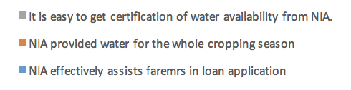
Perception about SSP
Borrower Perception on the Role of NIA in SSP
Figure 19. SSP borrower’s perception on the role of NIA

Slide 57
Borrower Perception on the Role of ATI in SSP
Figure 20. SSP borrower’s perception on the effectiveness of the trainings/seminars provided by ATI

Slide 58

Borrower Perception of the role of NFA in SSP
Figure 21. SSP borrower’s perception on the role of NFA

Slide 59
Figure 19. SSP borrower’s perception on the role of NFA

Slide 60
Borrower Perception on the Role of LBP in SSP

Slide 61
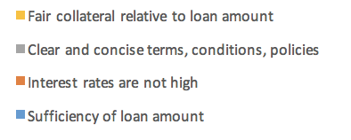
Figure 20. SSP Borrowers’ Perception on the Loan Features

Slide 63
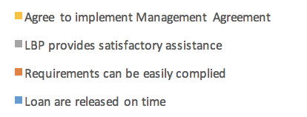
Figure 23. SSP Borrowers’ Perception on the Loan Administration by LBP

Slide 64
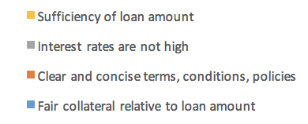
Non-Borrower Perception of SSP
Figure 24. Non-SSP Borrowers’ Perception on the Loan Features of SSP

Slide 65

Figure 25. Non-SSP Borrowers’ Perception on the Loan Administration by LBP

Slide 66
SUMMARY AND CONCLUSIONS

Slide 67
Extent of SSP contribution to
  Increased productivity –
    yield of borrowers is higher;
    around 10% of farmers shifted from inbred to hybrid with a 2t/ha yield difference
  Increased income –
    Partial budget analysis shows higher income for borrowers due to higher yield and low interest payment
    PSM shows impact on net income of P6,259 in DS
  SSP participation significantly and positively affects gross farm income
  Factors affecting SSP participation includes education (+), membership in other FO (+), household size (+), farm size (+), and tenure (-)

Slide 68
Improvement in access to credit
  Amount of loans granted
    Total cumulated loan as of April 2017 P4.7 B with P1 B in Isabela and Nueva Ecija
  Number of borrowers
    12,157 borrowers as of April 2017 covering 23,322 ha
  Fund leveraging
    10% of beneficiaries shifted from inbred to hybrid
    15% of beneficiaries use part of loans for small business, 10% for household expenses
    Sustained education of children, build houses
  Improved access to credit (survey results)
    Average loan amount increased from P67,899 to P104,511 per borrower per season
Extent of absorption of play harvest by NFA/reliable buyers
  Only small % of harvest in Bukidnon (10%), Mindoro,and Bohol (less than 50%) due to price difference

Slide 69
ATI credit worthiness
  Strictly enforced attendance to seminar as a requirement; results to increased appreciation of farmers
Complied with lending terms
  Interest rates
  Eligibility criteria
  Documentary requirements
  Status of service conduits
  Repayment performance
Gender dimension – 35% of beneficiaries are women
  Trends shows equal risks and opportunities for men and women
  Same trend in perception on the program and the institutions involved
  No women borrowers reported to have defaulted

Slide 70
Successful features
  Strong participation of IAs
    Use of concrete criteria in the selection of borrowers
    Presence of coordinators from IAs to assist borrowers in loan application
  Cooperation of all institutions involved in the program
    tapping of other credible buyers other than NFA, such as Bohol RPC
    Requiring a certain % of harvest to be brought to NFA
    expansion of collateral
    Presence of LGUs
  Loan features
    Low interest
    AGFP guarantee
    Collateral for safekeeping only
Positive perception of borrowers on all institutions involved; Neutral for NFA
Bottlenecks
  MTA implementation
  Monitoring and evaluation

Slide 71
RECOMMENDATIONS

Slide 72
Use of concrete criteria in selecting potential borrowers
Institutionalize coordinators in IA’s, to be subsidized by SSP
Revisit role of NFA, strictly enforce a % of harvest to be sold to NFA or accredited buyers
Expand loan collateral
Additional staff for LBP LC specific for SSP
Institutionalize involvement of LGUs
Expand role of ATI to provide technical trainings
Incentives to IAs must be given immediately
Consider substitute IDs for difficult ones like TIN
Redefine IAs of good standing in view of free ISF

Slide 73
PHOTO DOCUMENTATION

Slide 74
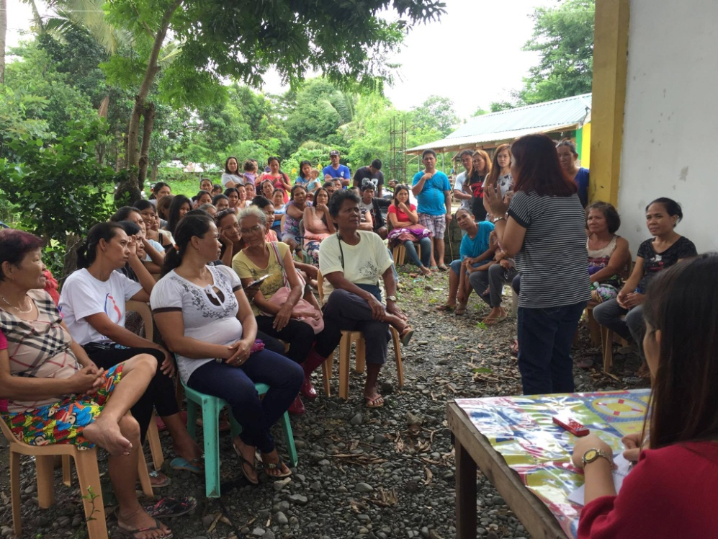
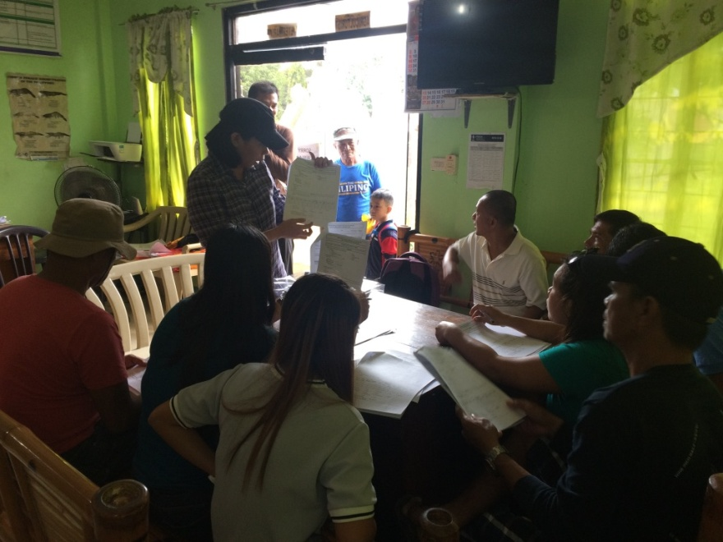
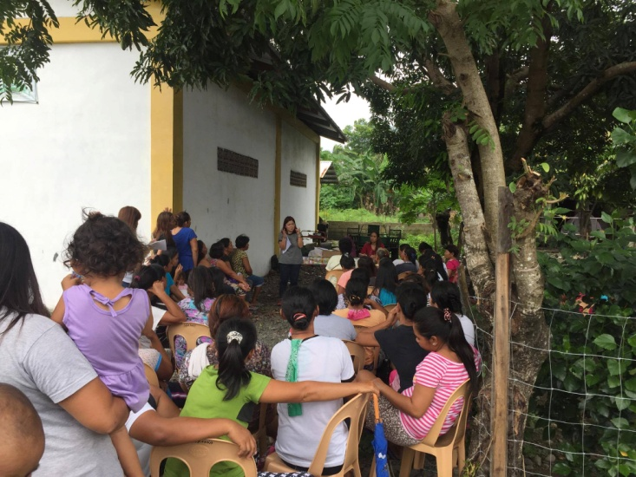
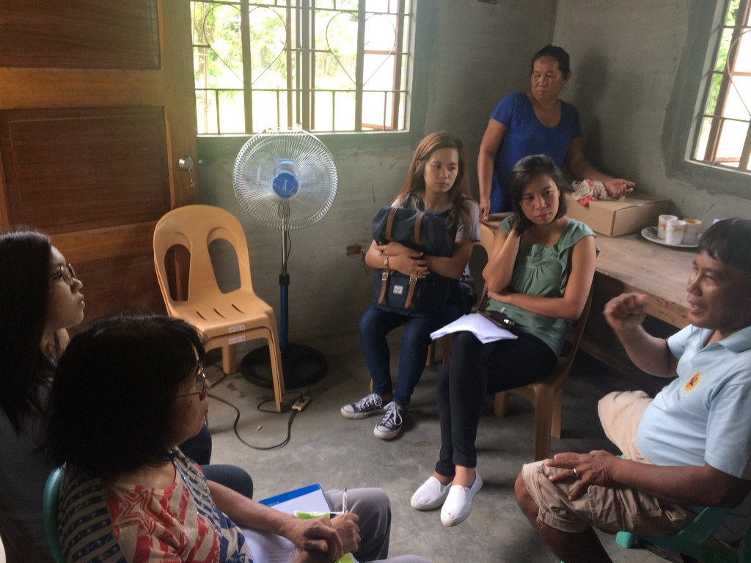
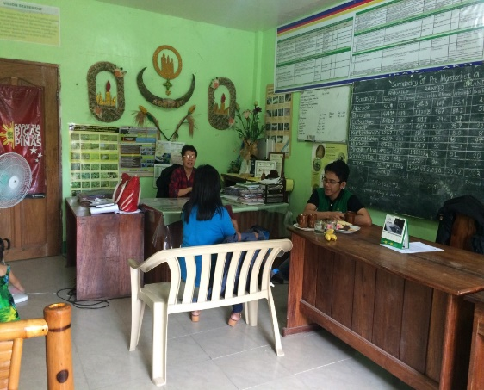
OCCIDENTAL MINDORO
Briefing of Interviewers
Focus Group Discussion in Rizal
Interview of IA Chairman in Rizal
Interview of MAO in Sta. Cruz

Slide 75
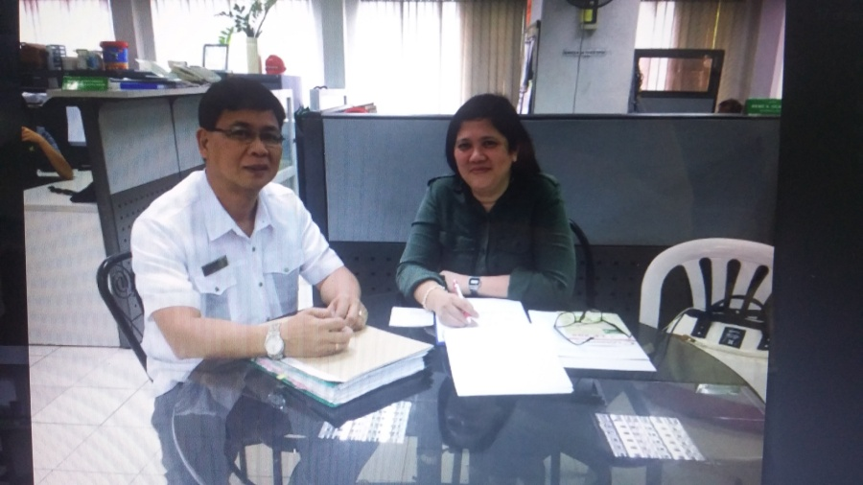
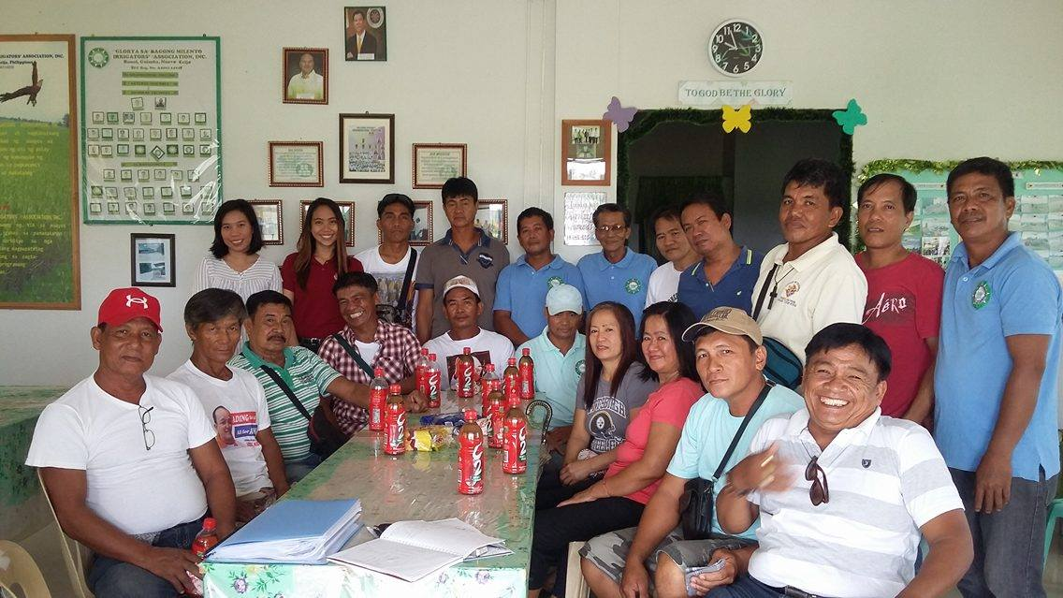
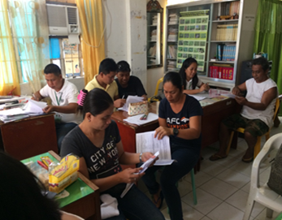
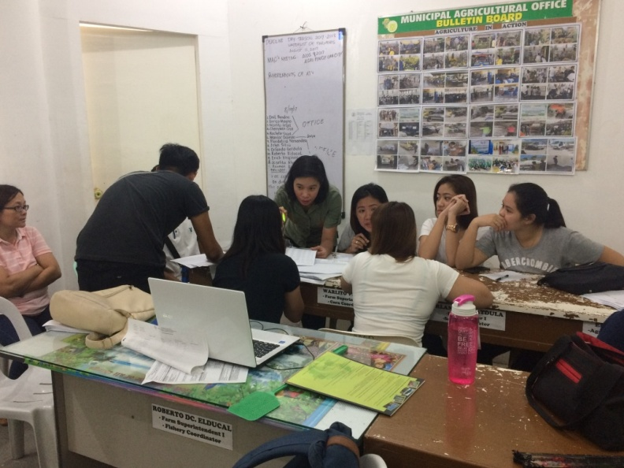
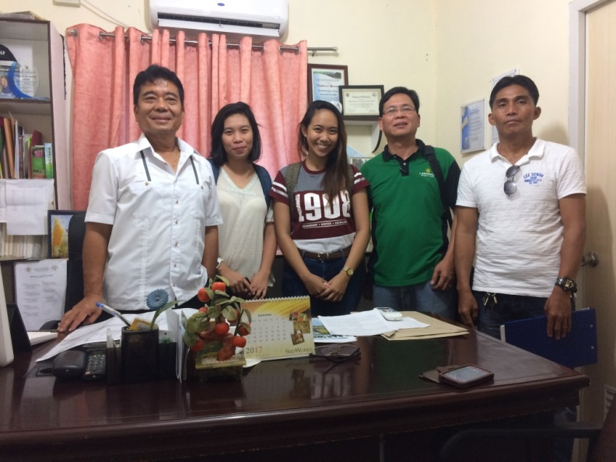
NUEVA ECIJA
Focus Group Discussion in Guimba
With Land Bank SSP Account Officer
Interview of MAO and IA Chairman in Guimba
Training of Enumerators

Slide 76
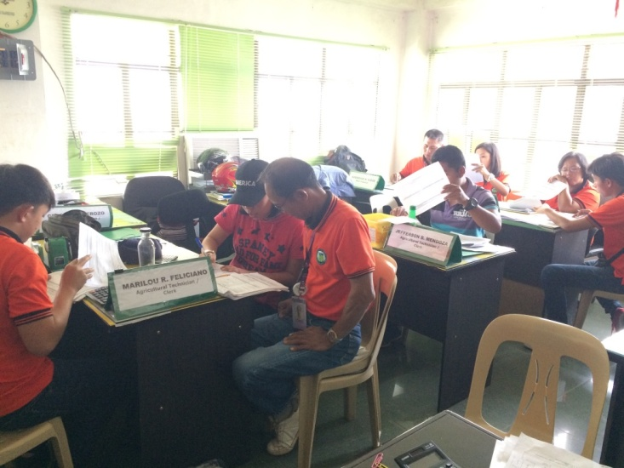
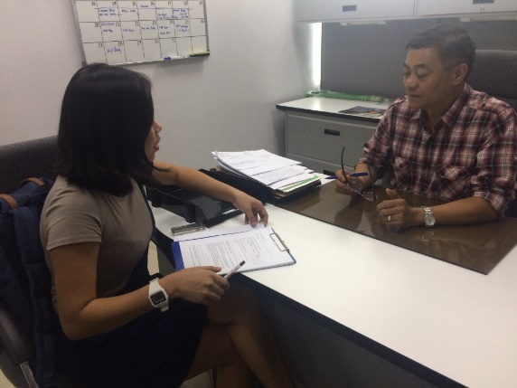
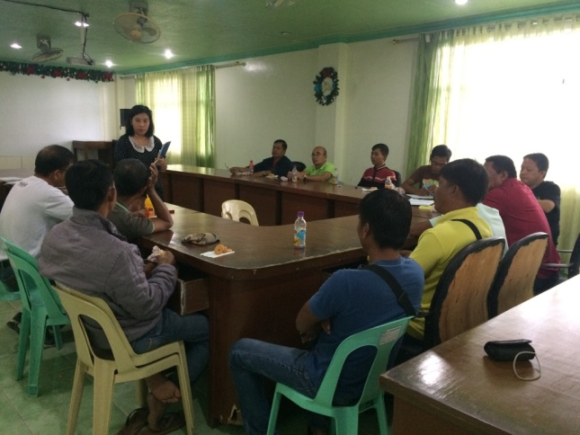
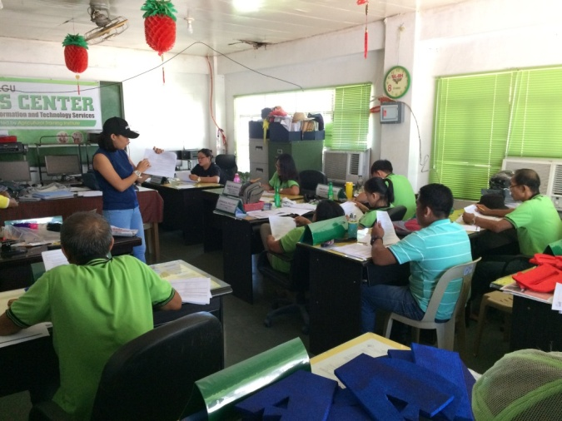
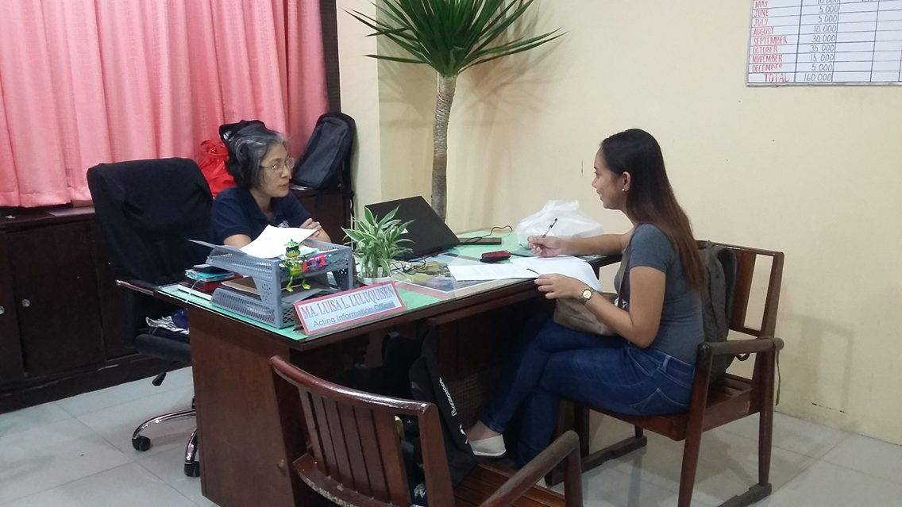
ISABELA
Training of Enumerators
With Land Bank VP-Cauayan
Focus Group Discussion in Santiago
With NFA-Santiago Manager Information Officer

Slide 77
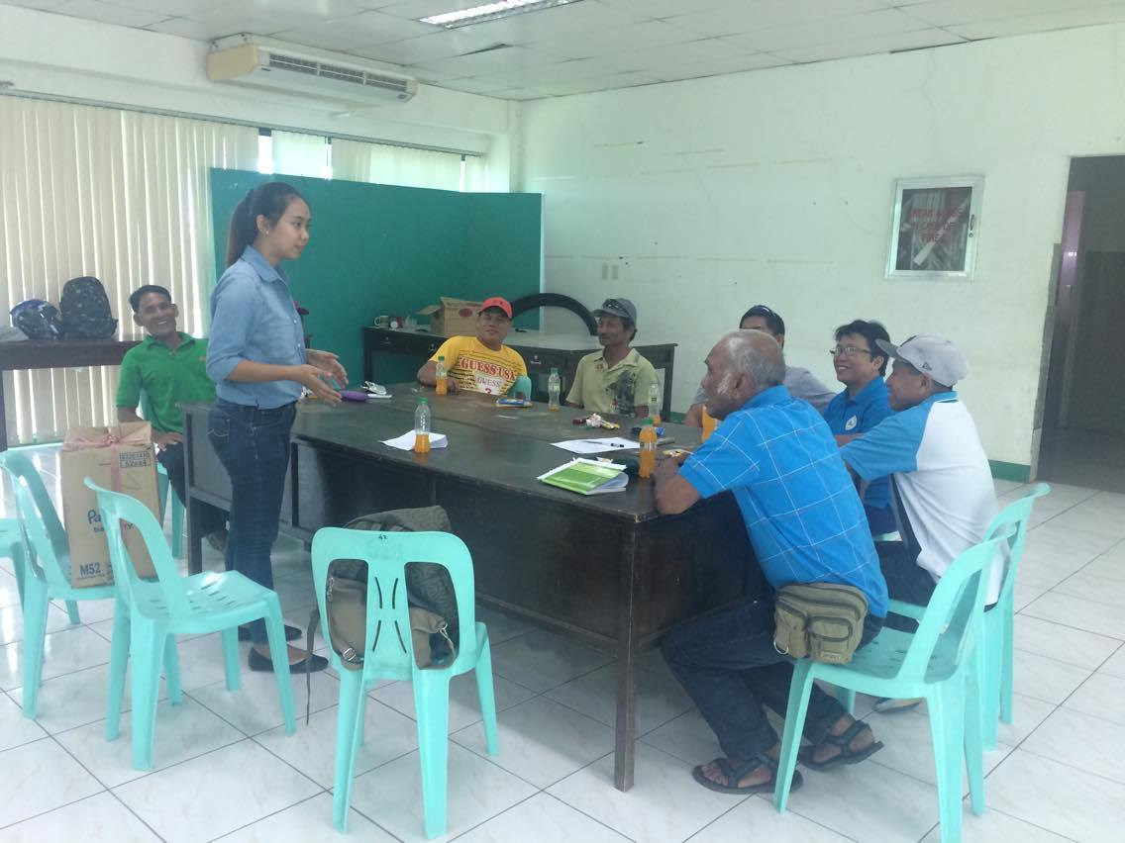
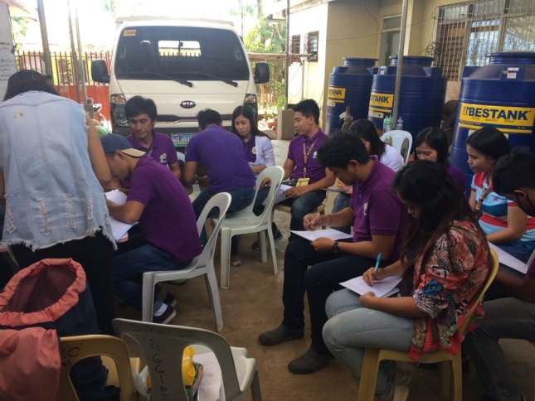
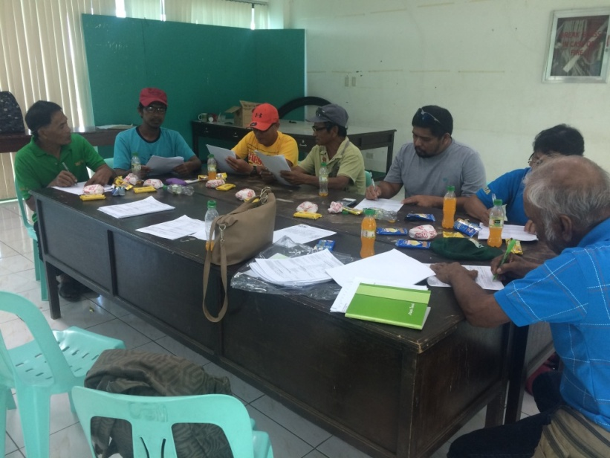
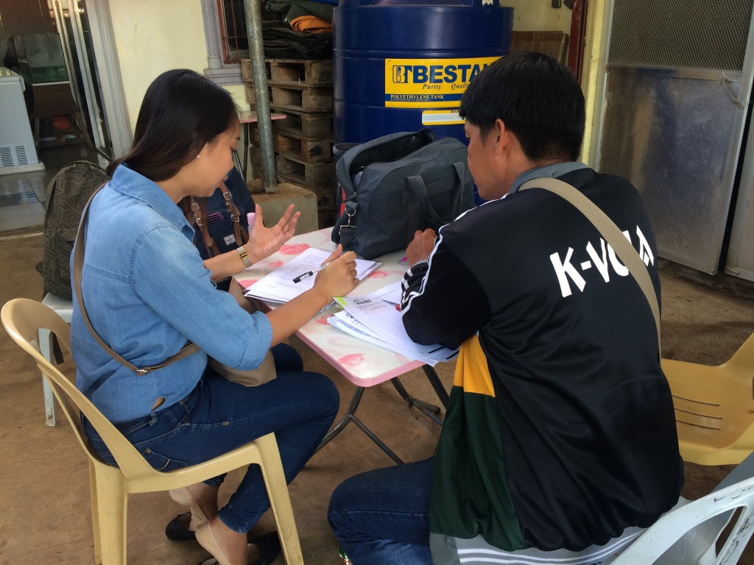
BUKIDNON
Focus Group Discussion in Malaybalay
Training of enumerators
KII with IA Officer in Valencia
Group interview of SSP farmers

Slide 78
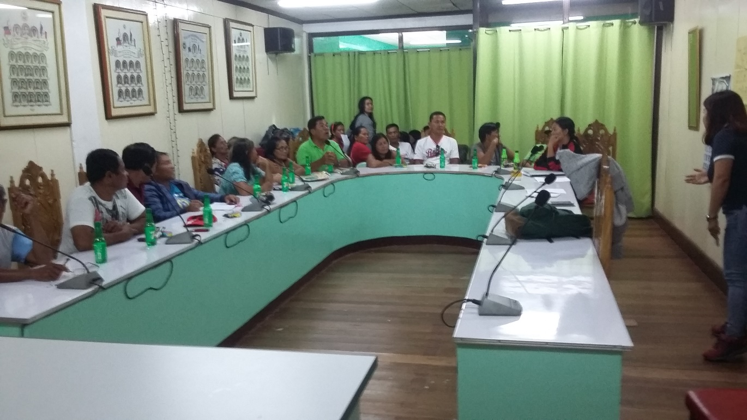
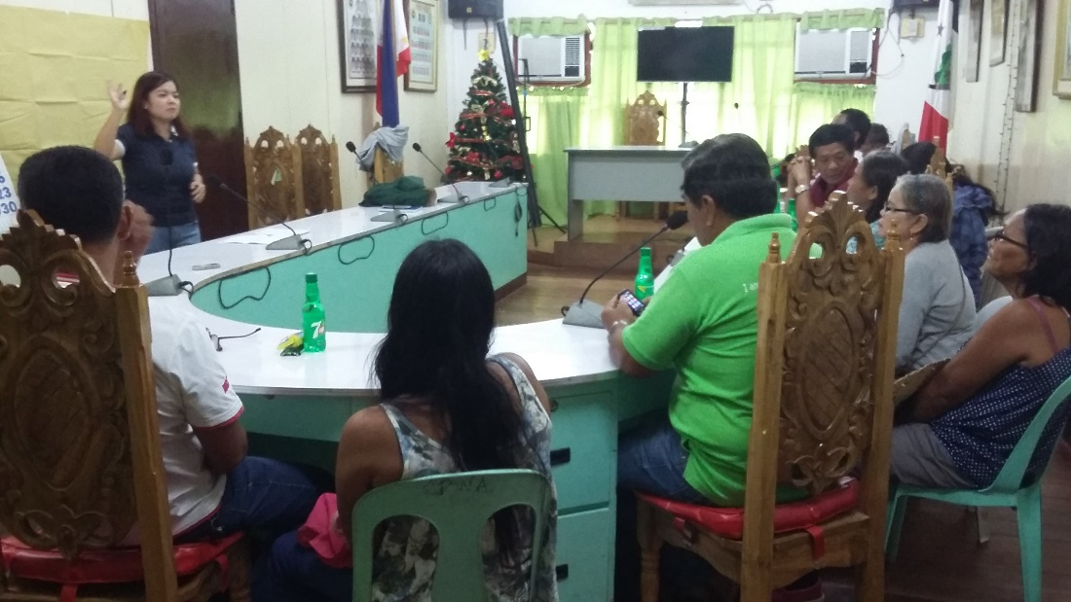
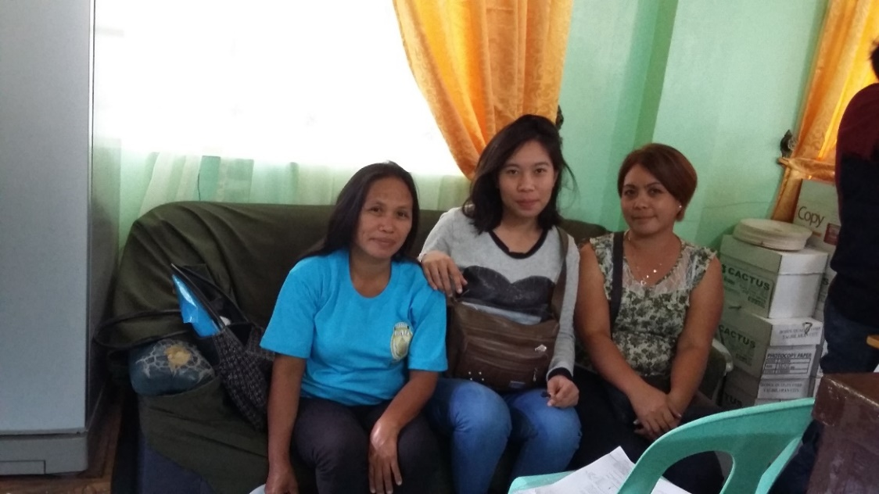
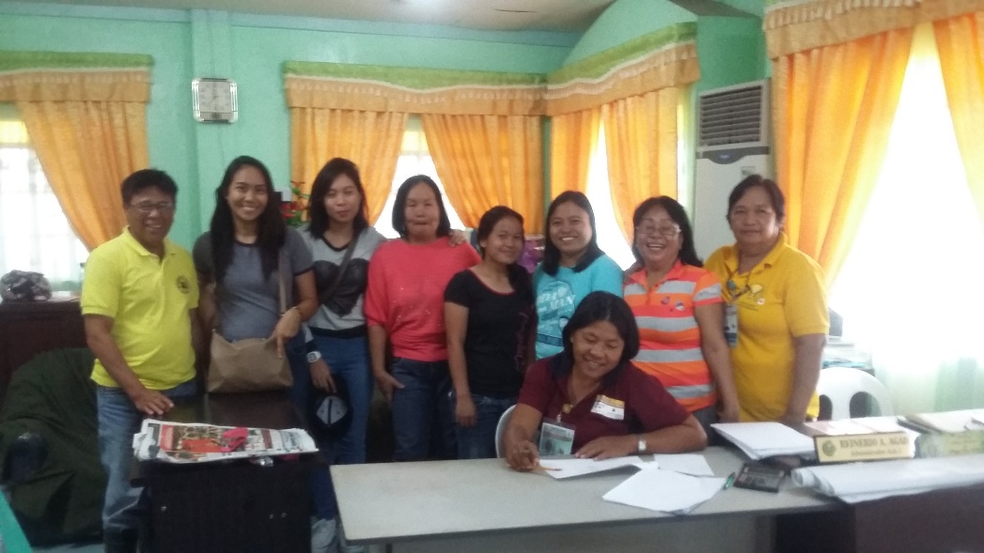
BOHOL
Focus Group Discussion in Pilar
Training of Enumerators
KII with IA Officers in Ubay

Slide 79
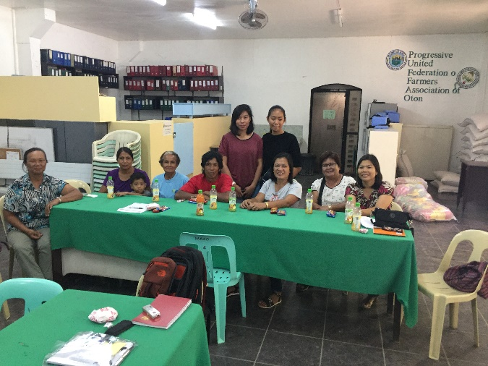
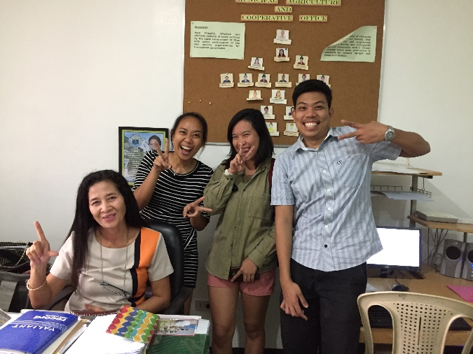
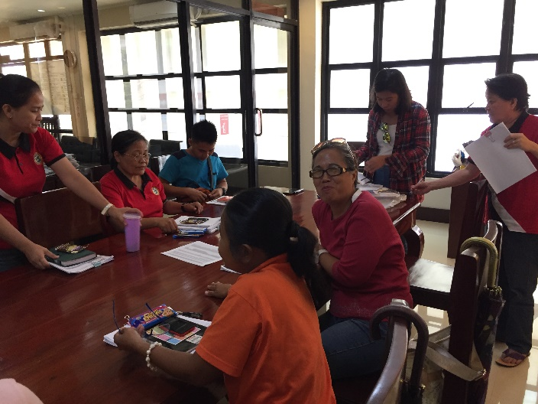
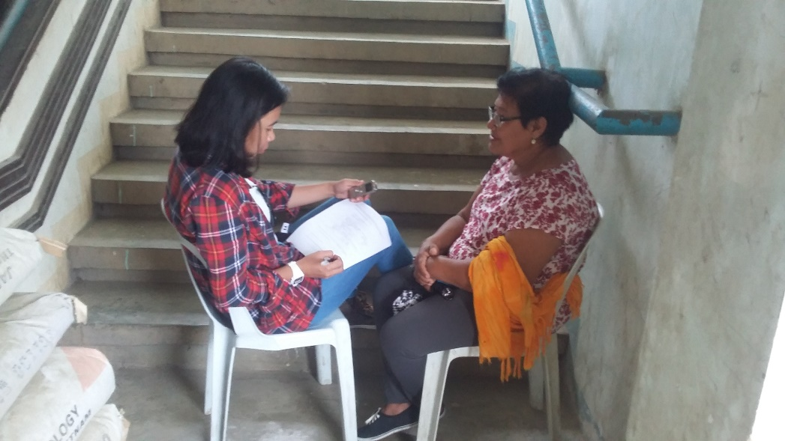
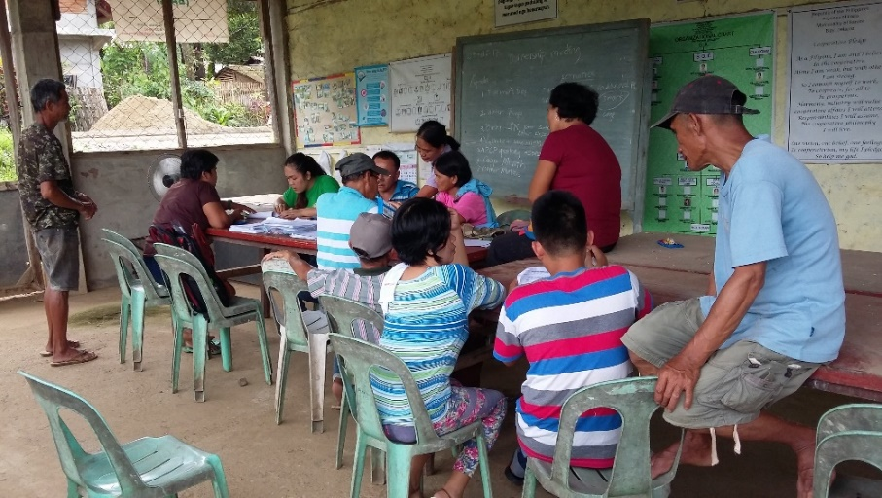
ILOILO
With MAO Oton and Land Bank SSP Account Officer
Training of Enumerators
Focus Group Discussion in Oton
KII with IA Officer in Barotac Viejo
Group interview of farmers

